Slide 1

CAP 5636 – Advanced Artificial Intelligence
Markov Models
Instructor: Lotzi Bölöni
  [These slides were adapted from the ones created by Dan Klein and Pieter Abbeel for CS188 Intro to AI at UC Berkeley, available at http://ai.berkeley.edu.]
Notes:
Please retain proper attribution, including the reference to ai.berkeley.edu. Thanks!
Note: pretty short lecture, good one to present mini-contest results or anything else not exactly lecture.

Slide 2
Reasoning over Time or Space
Often, we want to reason about a sequence of observations
  Speech recognition
  Robot localization
  User attention
  Medical monitoring
Need to introduce time (or space) into our models

Slide 3


Markov Models
  Value of X at a given time is called the state
  Parameters: called transition probabilities or dynamics, specify how the state evolves over time (also, initial state probabilities)
  Stationarity assumption: transition probabilities the same at all times
  Same as MDP transition model, but no choice of action
X₁
X₂
X₃
X₄

Slide 4
Joint Distribution of a Markov Model
X₁
X₂
X₃
X₄
  Joint distribution:
  More generally:
  Questions to be resolved:
    Does this indeed define a joint distribution?
    Can every joint distribution be factored this way, or are we making some assumptions about the joint distribution by using this factorization?

Slide 5
Chain Rule and Markov Models
X₁
X₂
X₃
X₄
From the chain rule, every joint distribution over can be written as:
Assuming that
and
results in the expression posited on the previous slide:

Slide 6
Chain Rule and Markov Models
X₁
X₂
X₃
X₄
From the chain rule, every joint distribution over can be written as:
Assuming that for all t:
gives us the expression posited on the earlier slide:

Slide 7
Implied Conditional Independencies
X₁
X₂
X₃
X₄
We assumed: and
Do we also have ?
  Yes!
  Proof:

Slide 8
Markov Models Recap
Explicit assumption for all t :
Consequence, joint distribution can be written as:
Implied conditional independencies: (try to prove this!)
  Past variables independent of future variables given the present
  i.e., if or then:
Additional explicit assumption: is the same for all t

Slide 9
Conditional Independence
Basic conditional independence:
  Past and future independent of the present
  Each time step only depends on the previous
  This is called the (first order) Markov property
Note that the chain is just a (growable) BN
  We can always use generic BN reasoning on it if we truncate the chain at a fixed length

Slide 10
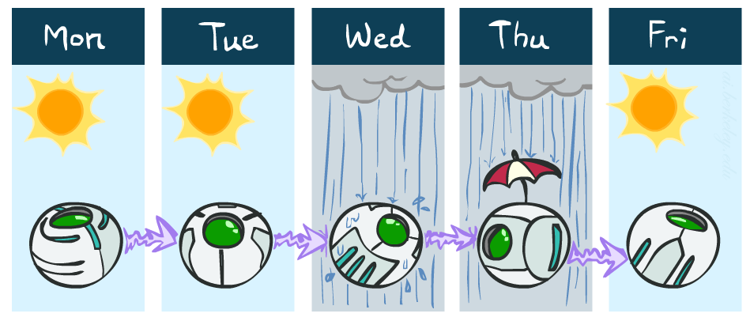
Example Markov Chain: Weather
States: X = {rain, sun}
Initial distribution: 1.0 sun
CPT P(X_{t} | X_{t-1}):
Two new ways of representing the same CPT
X_{t-1} | X_{t} | P(X_{t}|X_{t-1})
sun | sun | 0.9
sun | rain | 0.1
rain | sun | 0.3
rain | rain | 0.7
0.9
0.3
0.9
rain
sun
sun
sun
0.1
0.3
rain
rain
0.7
0.7
0.1

Slide 11
Example Markov Chain: Weather
0.9
Initial distribution: 1.0 sun
What is the probability distribution after one step?
0.3
rain
sun
0.7
0.1

Slide 12
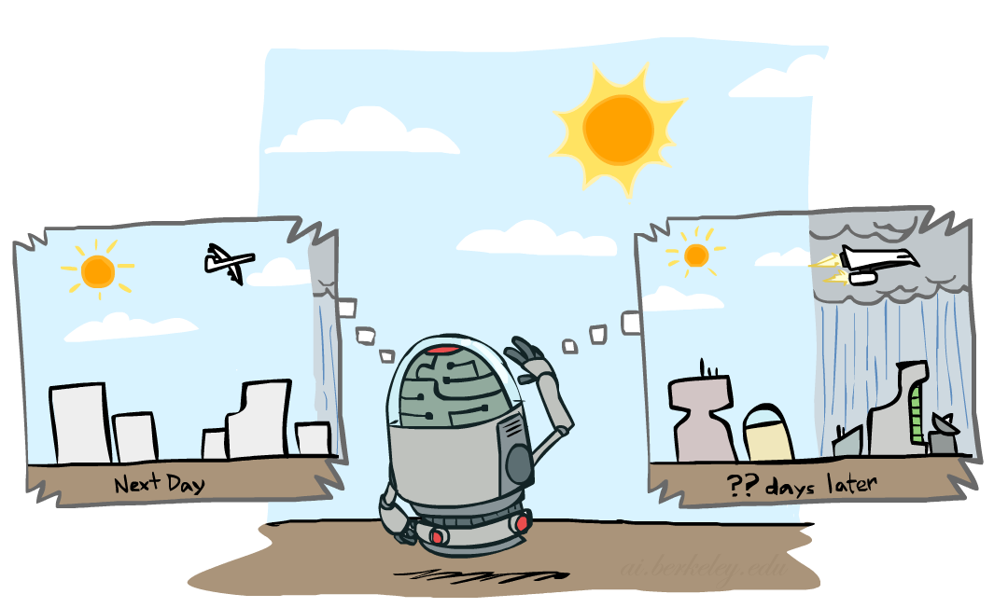

Mini-Forward Algorithm
Question: What’s P(X) on some day t?
X₁
X₂
X₃
X₄
Forward simulation

Slide 13
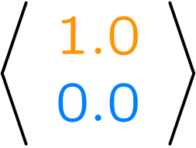
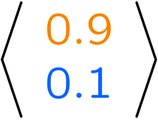
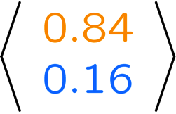
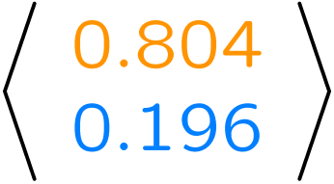
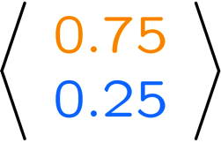
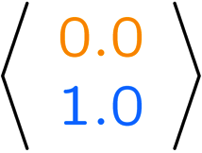
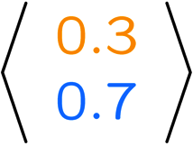
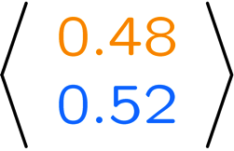
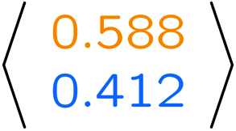
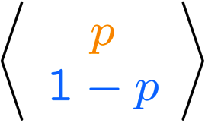
Example Run of Mini-Forward Algorithm
From initial observation of sun
From initial observation of rain
From yet another initial distribution P(X₁):
P(X₁)
P(X₂)
P(X₃)
P(X₄)
P(X∞)
P(X₁)
P(X₂)
P(X₃)
P(X₄)
P(X∞)
…
P(X₁)
P(X∞)
[Demo: L13D1,2,3]

Slide 14

Video of Demo Ghostbusters Basic Dynamics

Slide 15
Video of Demo Ghostbusters Circular Dynamics

Slide 16
Video of Demo Ghostbusters Whirlpool Dynamics

Slide 17

Stationary Distributions
For most chains:
  Influence of the initial distribution gets less and less over time.
  The distribution we end up in is independent of the initial distribution
Stationary distribution:
  The distribution we end up with is called the stationary distribution of the chain
  It satisfies

Slide 18
Example: Stationary Distributions
Question: What’s P(X) at time t = infinity?
X₁
X₂
X₃
X₄
X_{t-1} | X_{t} | P(X_{t}|X_{t-1})
sun | sun | 0.9
sun | rain | 0.1
rain | sun | 0.3
rain | rain | 0.7
Also:

Slide 19
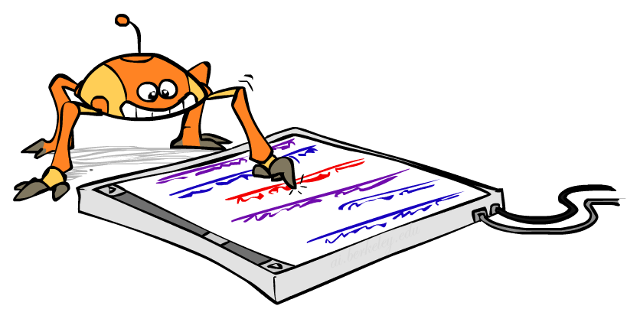
Application of Stationary Distribution: Web Link Analysis
PageRank over a web graph
  Each web page is a state
  Initial distribution: uniform over pages
  Transitions:
    With prob. c, uniform jump to a
    random page (dotted lines, not all shown)
    With prob. 1-c, follow a random
    outlink (solid lines)
Stationary distribution
  Will spend more time on highly reachable pages
  E.g. many ways to get to the Acrobat Reader download page
  Somewhat robust to link spam
  Google 1.0 returned the set of pages containing all your keywords in decreasing rank, now all search engines use link analysis along with many other factors (rank actually getting less important over time)
Notes:
Before: most search engines were merely based on how well a page matches your search words.
Note: currently dominated by clickstreams

Slide 20

Application of Stationary Distributions: Gibbs Sampling*
Each joint instantiation over all hidden and query variables is a state: {X₁, …, X_{n}} = H U Q
Transitions:
  With probability 1/n resample variable X_{j} according to
  P(X_{j} | x₁, x₂, …, x_{j-1,} x_{j+1}, …, x_{n,} e_{1,} …, e_{m})
Stationary distribution:
  Conditional distribution P(X₁, X₂ , … , X_{n}|e_{1,} …, e_{m})
  Means that when running Gibbs sampling long enough we get a sample from the desired distribution
  Requires some proof to show this is true!
Notes:
With re-ordering of topics, can’t cover this here yet, need to wait till after sampling.

Slide 21
Next Time: Hidden Markov Models!

